Slide 1

North South University
Fall 2020
ENG111.3
An informative speech on
“Memory Techniques”
Source: https://clockify.me/blog/wp-content/
Submitted By:
Md Sharif Hossain
ID: 1712336042
Faculty: Shapla Parveen

Slide 2

Memory recall failure?
Can’t remember things
when you need it?
I’ve solution techniques!
Source: https://us.123rf.com/450wm/

Slide 3
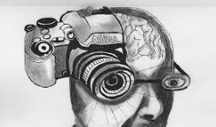
Attention
Building a Story
Taking a Break
Making Repetition
Source: http://www.newspatrolling.com/photographic-memory-what-is-it-all-about/

Slide 4

Attention
Proper Attention is the first condition for a successful Encoding
Source: https://zapier.com/blog/better-memory/

Slide 5

Attention
Less Distraction creates more Attention
Source: https://www.wetakeclasses.com/how-to-overcome-distractions-while-studying-online/

Slide 6
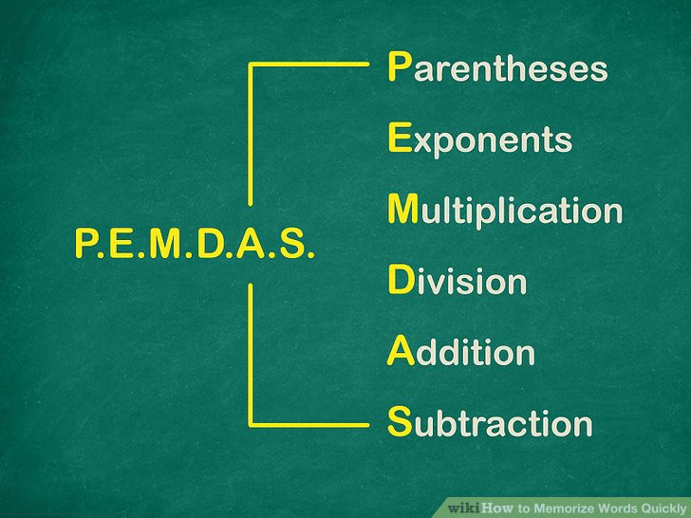
Connecting the words or Creating Stories
Connecting the words is the second technique to memorize effectively
Source: https://www.wikihow.com/Memorize-Words-Quickly

Slide 7

Taking a Break
A short Break can Recharge your memory!
Source: https://www.chegg.com/study-101/improve-memory-studying/

Slide 8
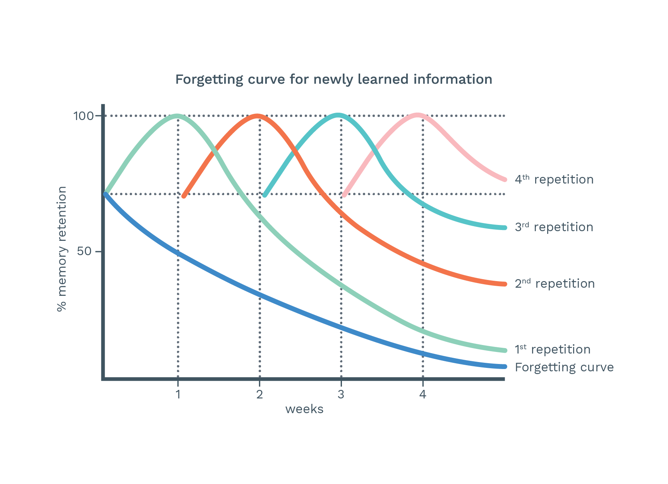
Making repetition
Repetition makes memories long lasting!
Source: https://quitch.com/backed-by-science/

Slide 9
Attention
Building a Story
Taking a Break
Making Repetition

Slide 10

Bonus Technique!
Teach anyone
else
Source: https://images.app.goo.gl/eLVKCdEZN75h7eDt8

Slide 11
Thank you everyone!

Slide 12
?

